Slide 1


VAMAP
A SIMPLE USER DATA-DRIVEN MAP-ANALYZING TOOL BASED ON FOLIUM
Team 16 SUNGJAE MIN SANGMIN LEE
HYUNJAE LEE SEOKCHEON JU

Slide 2
Team 16
Team Introduction
Needs & Similar services
VAMAP’s Identity
Minimum Viable Product
Demo
Future development

Slide 3
Team leader
HYUNJAE LEE
Seokcheon ju
Sangmin lee
BACKEND DEVELOPER
Sungjae min
Jane Doe
Jane Doe
Jane Doe
Jane Doe
README 작성
도로데이터 전처리 구현 (roadmanager.py)
Main 함수 구성 및 기타 함수들 구현 (main.py, load.py, map3d.py, marker_func.py)
Documentation
입력된 엑셀 정보를 읽어서 전처리를 하는 함수 구현 (dataproc.py)
데이터 수집 (user, roads, others)
사용자의 입력값들을 검증하기 위한 파싱 구현 (parser.py)
데이터 수집 (choropleth)
유저데이터와 입력데이터들 간의 연산 구현 (scoring.py)
데모 시연
leehj8687@gmail.com
alstjdwo1601@naver.com
smallfish06@cau.ac.kr
snt.oceaner@gmail.com

Slide 4
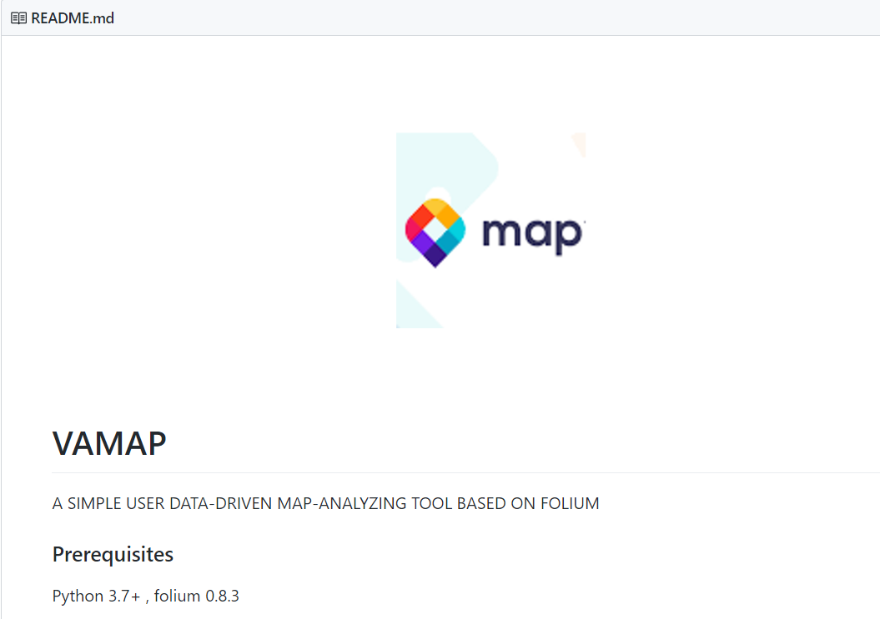
Needs?

Slide 5


others
VAMAP
Distance

Slide 6
VAMAP
Distance
각 유저데이터 객체가 거리 연산을 기반으로
가치를 가진다.
이 가치는 꼭 있어야할 곳에 반드시 있는지,
혹은 있지 않아도 될 곳에 무분별하게 있는지
등을 판단할 수 있는 척도가 될 수도 있고,
가치의 크기에 따라 해당 위치의 효율성도 판단할 수 있다.

Slide 7
Similar Services

Slide 8


Already developed?
QGIS - Map Data Visualization
KNIME – Data preprocessing
VAMAP
§ Data preprocessing (User Input , Excel files)
§ Data calculation (Geo Distance, Data relation)
§ Data validation check (parser)
§ Map data visualization (Marker, Coverage)

Slide 9
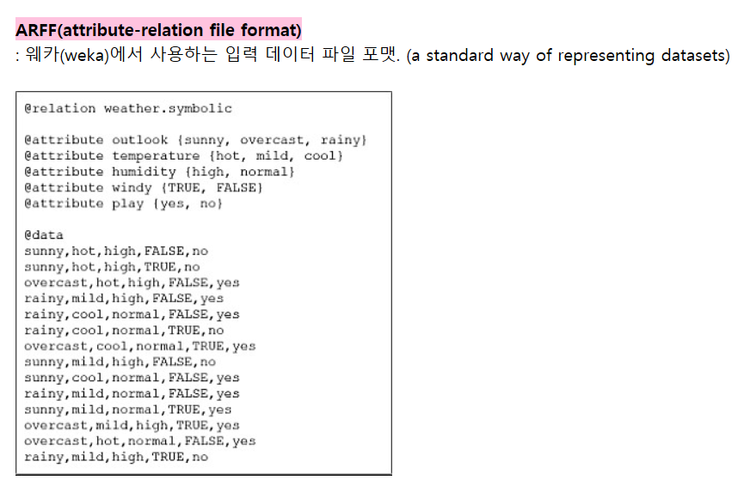
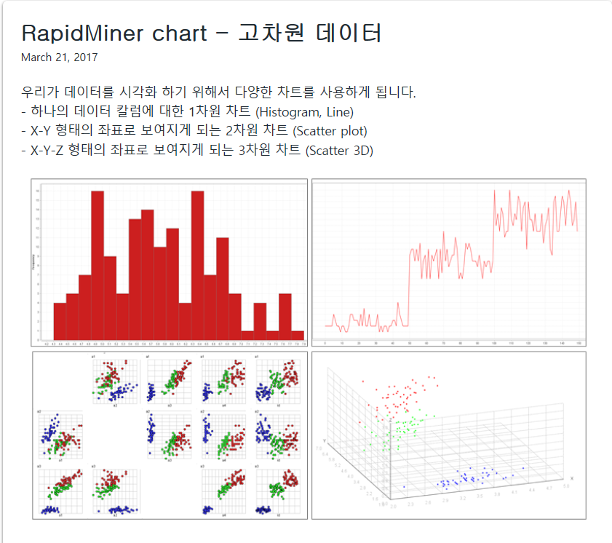
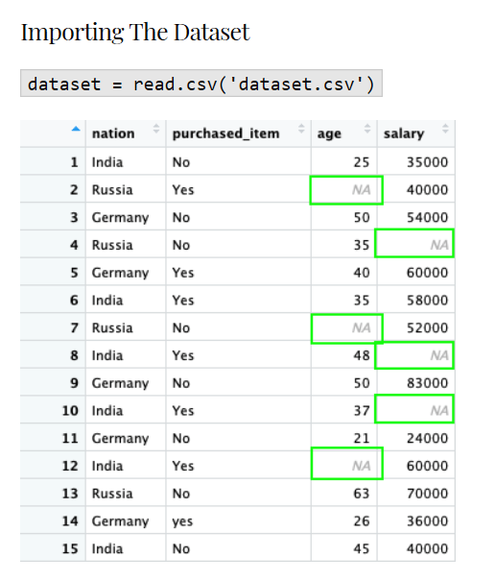
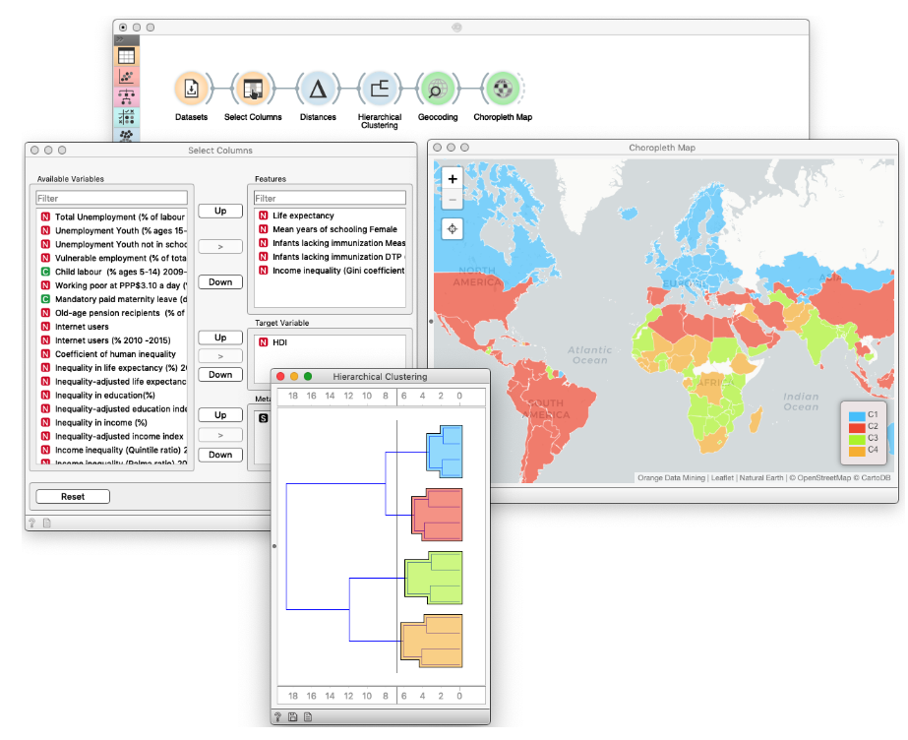
Etc…

Slide 10
Already developed?
 | QGiS | WEKA | Rapidminer | Knime | VAMAP
Data Preprocessing | O | O | O | O | O
Data Visualization | O | O | O | O | O
Provide Map | O | X | O | O | O
Open Source | O | O | O | O | O
Deal with Excel | O | O | O | O | O
User data Input | O | O | O | O | O
Data Relationship | X | X | X | O | O
Calculate Data Value with Weight | X | X | X | X | O
Data Form designation | X | X | X | X | O

Slide 11
Identity

Slide 12
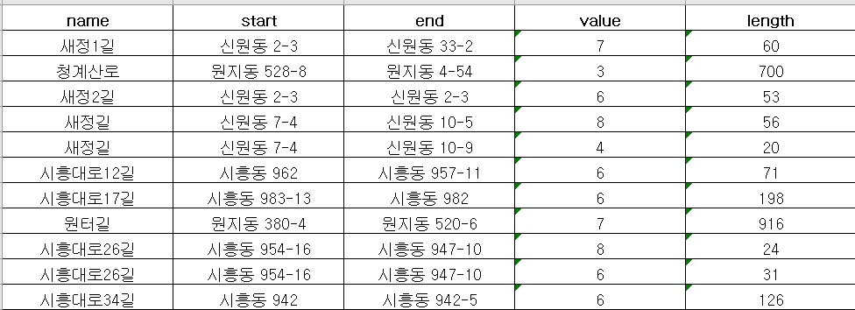
1. Road data preprocessing
Focused on utility
Identity

Slide 13
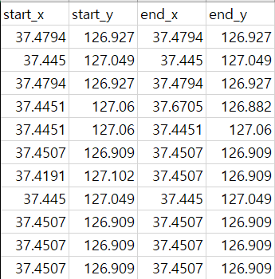
1. Road data preprocessing
Focused on utility
Identity

Slide 14




2. Parser
Focused on easy-to-use
Identity
Parser.py
Error Handling
Parser.py
Main.py
Setup.txt
Input Data
Excel files

Slide 15
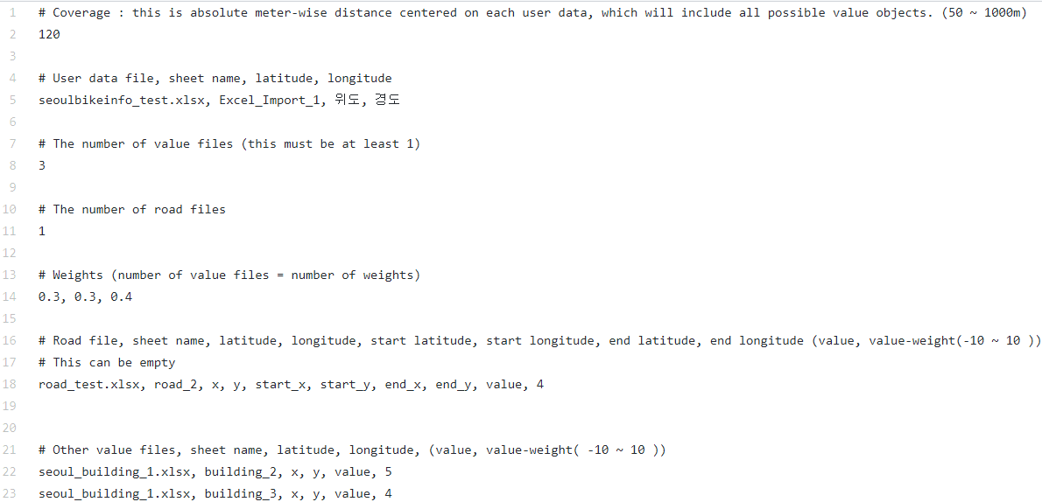
2. Parser
Focused on easy-to-use
Identity
Parser.py

Slide 16
2. Parser
Focused on easy-to-use
Identity
Parser.py
Error Handling?
1. Check Setup.txt , Excel files path & existence
2. Check validation of Setup.txt , Excel files
3. If error occurs, parser
print error message

Slide 17
3. Data preprocessing
Focused on easy-to-use
Identity
Data preprocessing
datalist=[[numpy.array][numpy.array]…]

Slide 18


4. Scoring by distance
Focused on easy-to-use
Identity
Scoring by distance
Return Data
Score.py
Deliver Data
Main.py
Deliver Info
Request Data

Slide 19
4. Scoring by distance
Focused on easy-to-use
Identity
Scoring by distance
VAMAP
Score.py
Distance

Slide 20
Minimal Viable Product

Slide 21
Minimum Viable Product
What we have planed
Parser
Road Manager
Scoring
Data preprocessing
Folium map
Folium choropleth
Html separation

Slide 22
Minimum Viable Product
What we have done
Parser
Road Manager
Scoring
Data preprocessing
Folium map
Folium choropleth
Html separation

Slide 23
Minimum Viable Product
What we have done
Parser
Road Manager
Scoring
Data preprocessing
Folium map
Folium choropleth
Html separation
Member roles
Sungjae Min
Hyunjae Lee
Sangmin Lee
Seokcheon Ju
Hyunjae Lee
ALL

Slide 24
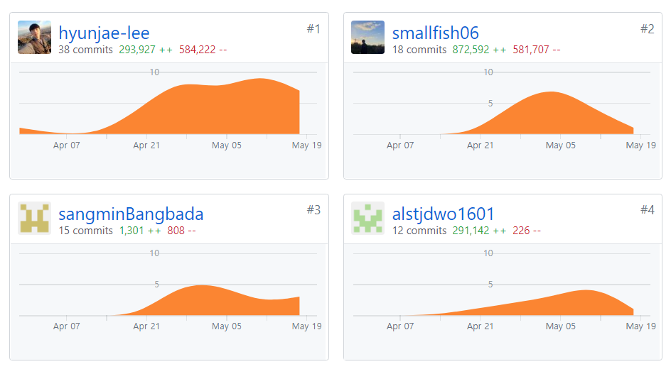
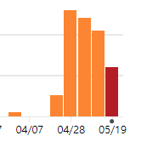
Github log 등을 통해 얼마나 협업
Minimum Viable Product

Slide 25
Demo

Slide 26
Future Development

Slide 27
Future Development
We are open to have your contributions!
Another calculation method
Feature Clustering using folium

Slide 28



Future Development
1. Another calculation method

Slide 29
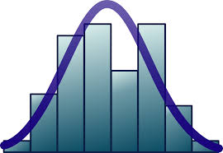
Future Development
1. Another calculation method
longitude
#object
latitude
Variance

Slide 30
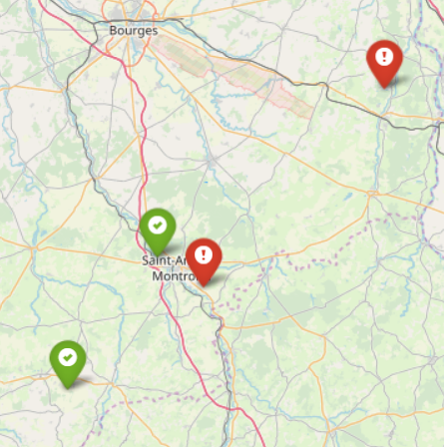
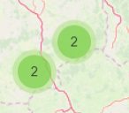
Future Development
2. Feature Clustering using folium
reference

Slide 31
Future Development
3. Finish MVP features
Folium choropleth
Html separation

